Slide 1
Solar Energy Calculations Renewable Energy Sources
SlideMake.com

Slide 2
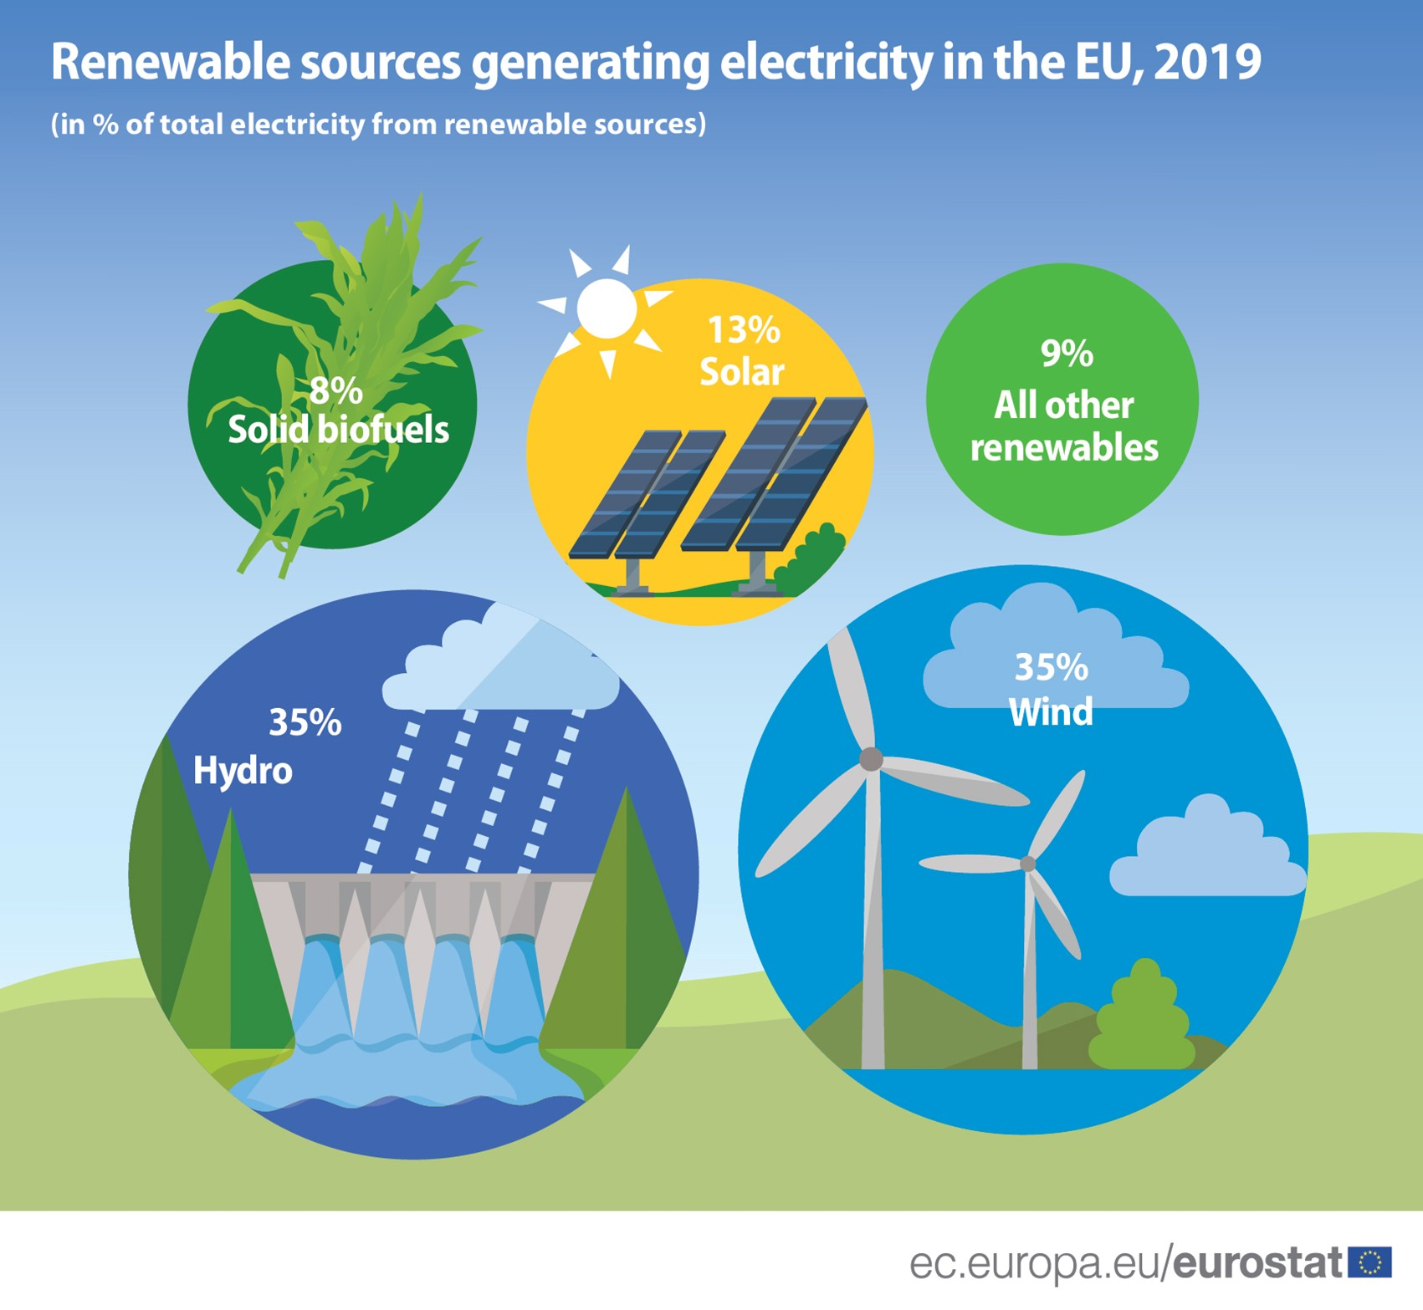
Introduction to Solar Energy Calculations and Renewable Energy Sources
Solar energy calculations are essential for estimating the potential energy output of solar power systems.
Renewable energy sources, such as solar energy, are crucial for reducing greenhouse gas emissions and achieving sustainability goals.
This presentation will explore the key aspects of solar energy calculations and highlight the importance of renewable energy sources.
Notes:
Image source: https://www.animalia-life.club/qa/pictures/energy-sources

Slide 3
Solar Energy Basics
Solar energy is the radiant heat and light from the sun that can be converted into useful energy.
Photovoltaic (PV) systems are the most common type of solar energy systems, converting sunlight directly into electricity.
Solar thermal systems use sunlight to heat water or air, providing hot water or space heating.
Notes:
Image source: https://www.scienceabc.com/innovation/solar-energy-working-photovoltaic-pv-cells-silicon-inverter-thermal-collector-flat-plate.html

Slide 4
Solar Energy Potential Assessment
Solar energy potential assessment involves determining the amount of solar radiation available at a specific location.
Factors such as latitude, climate, shading, and tilt angle affect the solar energy potential.
Sophisticated tools and software are used to calculate solar energy potential accurately.
Notes:
Image source: https://ar.inspiredpencil.com/pictures-2023/nasa-solar-energy-information

Slide 5
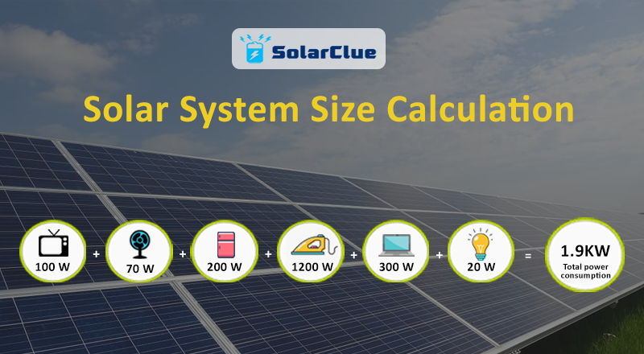
Solar Energy Calculation Methods
Solar energy calculations involve estimating the system's energy output based on the available solar radiation.
The most common method is using the PVWatts calculator, which considers various factors such as system size, location, and efficiency.
Other methods include using mathematical models and simulation software to analyze solar energy generation.
Notes:
Image source: http://blog.solarclue.com/blog/solar-system-size-calculation/

Slide 6
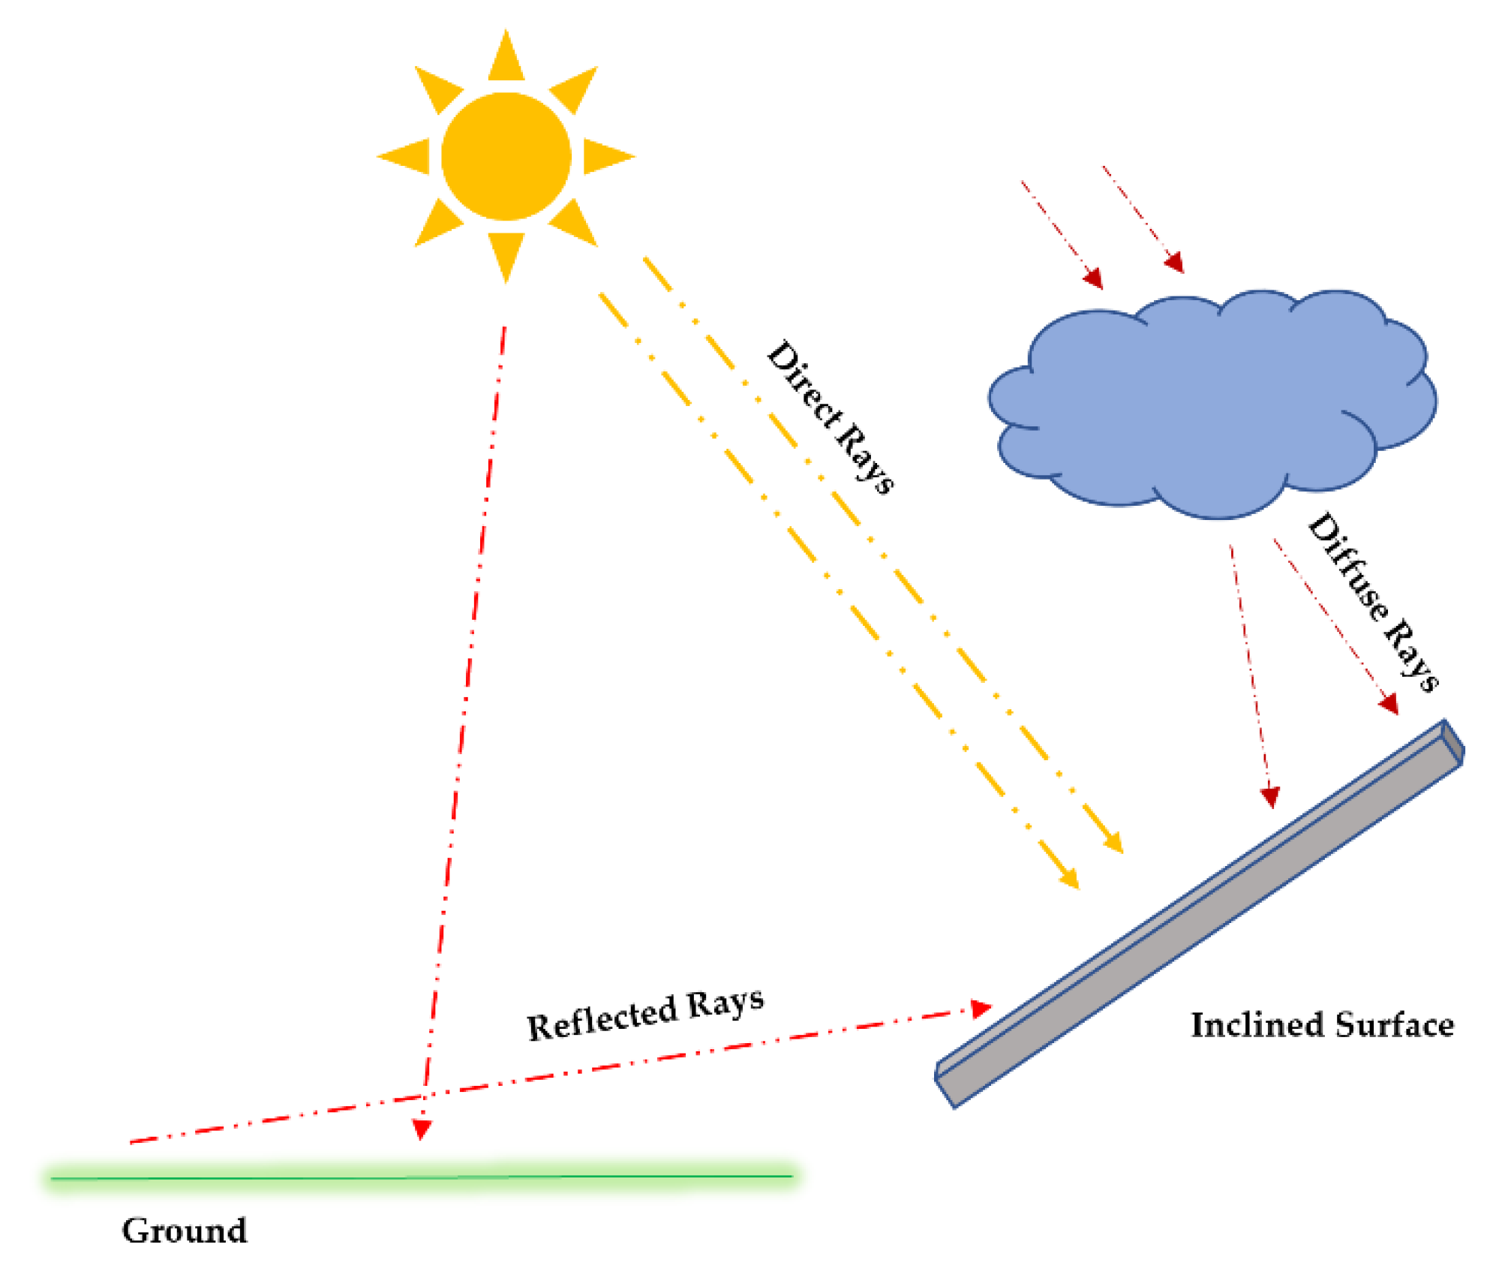
Factors Affecting Solar Energy Calculations
The orientation and tilt angle of solar panels affect the amount of solar radiation they receive.
Shading from nearby structures, trees, or other obstacles reduces the energy output.
Panel efficiency, temperature, and dust accumulation also impact solar energy calculations.
Notes:
Image source: https://www.mdpi.com/2673-9941/1/1/5

Slide 7
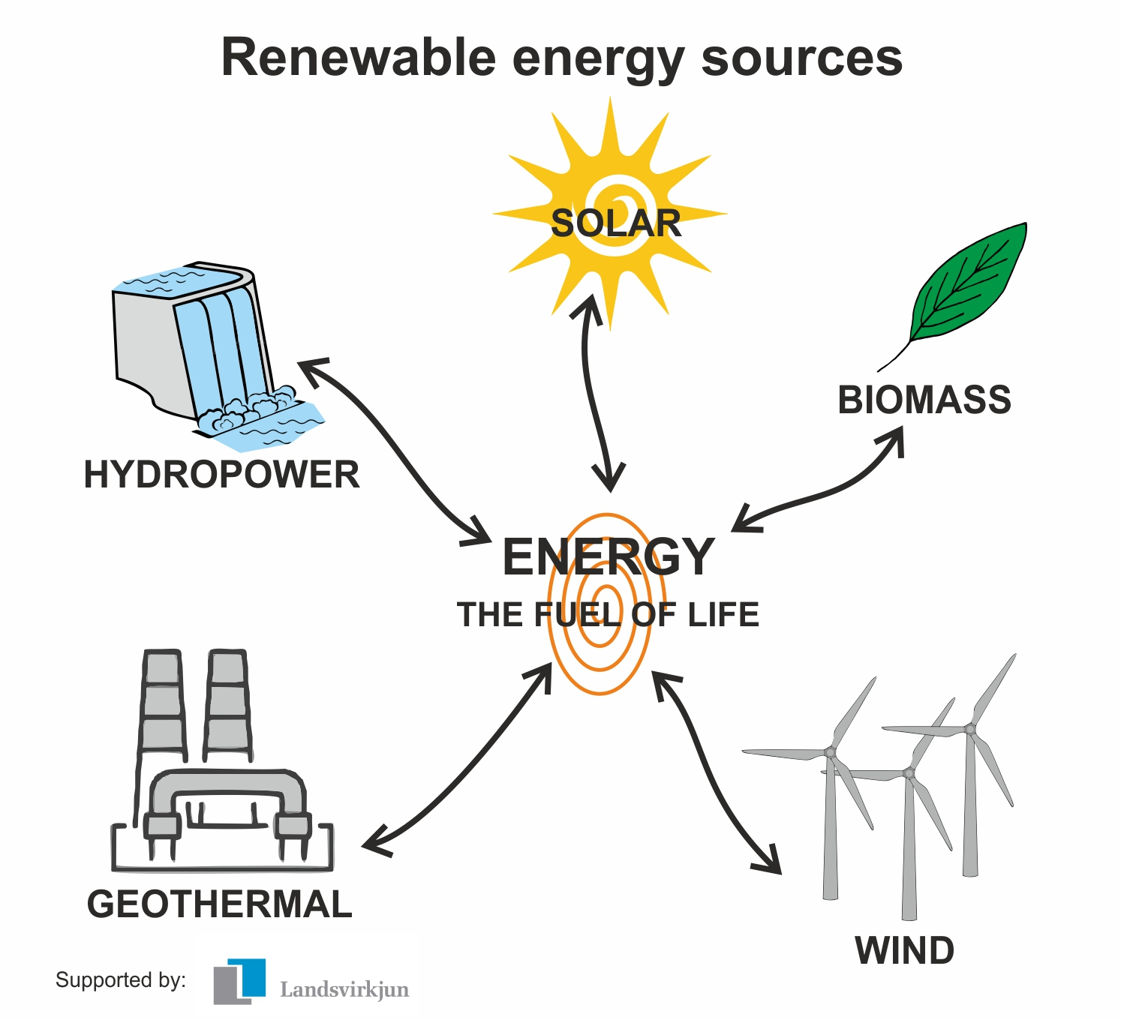
Importance of Renewable Energy Sources
Renewable energy sources, including solar energy, are crucial for reducing reliance on fossil fuels and combating climate change.
They provide a sustainable and clean alternative to traditional energy sources.
Investing in renewable energy sources helps create jobs, improve energy security, and stimulate economic growth.
Notes:
Image source: https://www.vlr.eng.br/pinocho-cuento/renewable-energy-sources-and-types-ww-2378974

Slide 8

Solar Energy Return on Investment (ROI)
Calculating the ROI of a solar energy system involves considering the initial investment, energy savings, and incentives.
Solar energy systems typically have a positive ROI due to long-term energy savings and potential income from excess energy generation.
The ROI of solar energy systems can vary based on factors such as location, system size, and available incentives.
Notes:
Image source: https://rectifysolar.com/tag/solar-return-on-investment/

Slide 9
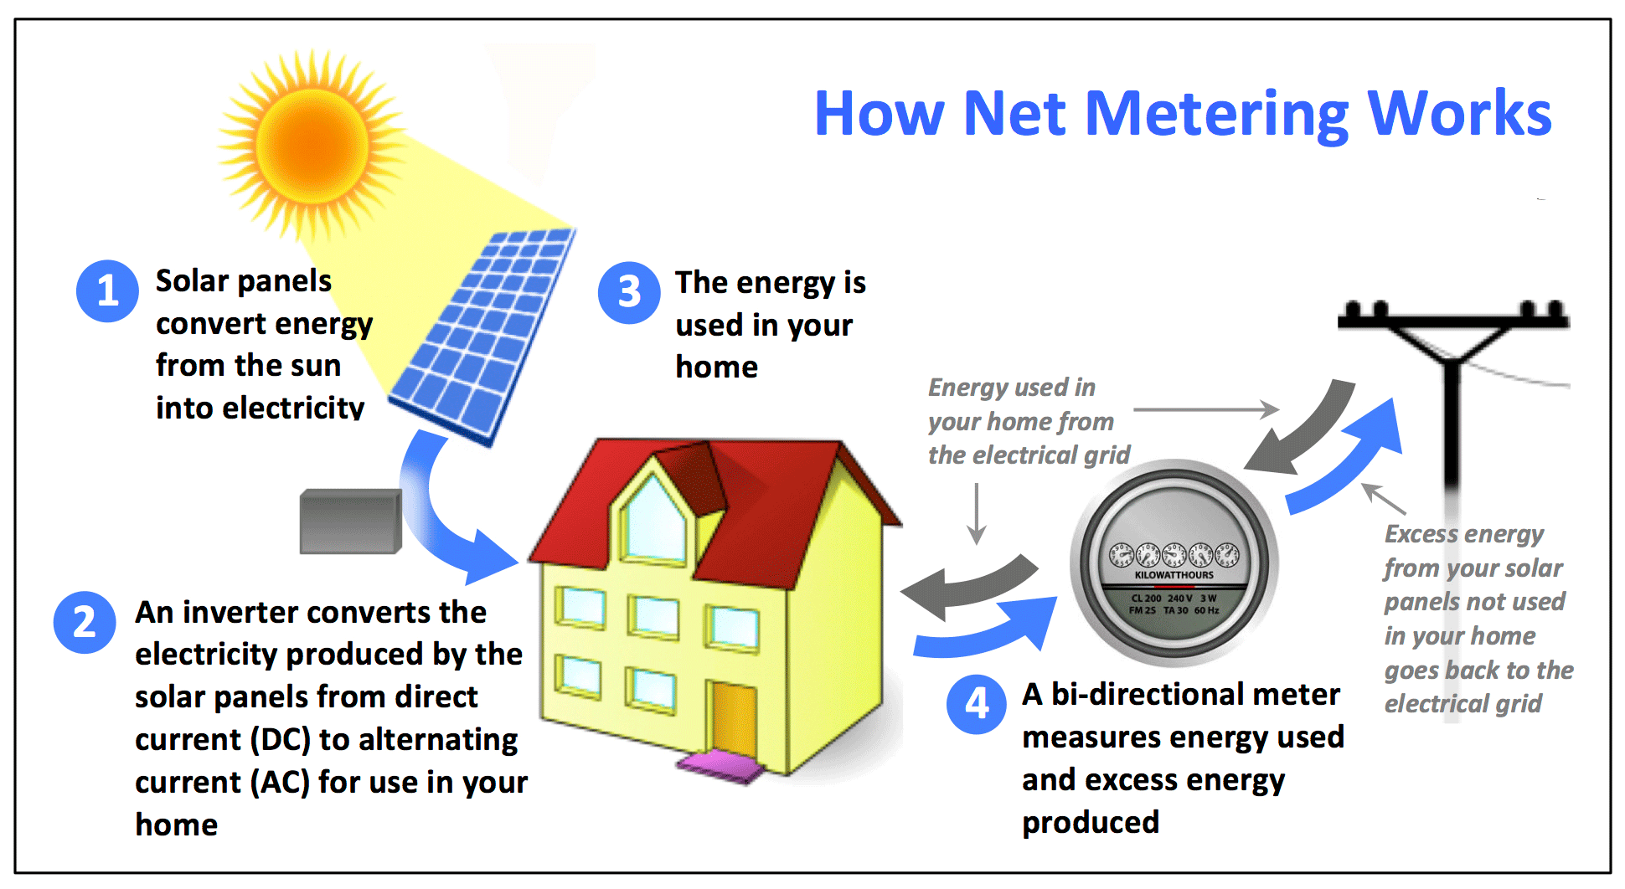
Net Metering and Feed-in Tariffs
Net metering allows solar energy system owners to send excess electricity back to the grid, earning credit for future use.
Feed-in tariffs provide a guaranteed payment for every unit of electricity generated by a renewable energy system.
These policies incentivize the adoption of solar energy systems and promote renewable energy generation.
Notes:
Image source: https://www.solaflect.com/how-does-net-metering-work/

Slide 10

Solar Energy Storage
Solar energy storage systems, such as batteries, allow for the storage of excess energy generated during peak sunlight hours.
Stored energy can be used during periods of low sunlight or during power outages, increasing energy self-sufficiency.
Advances in energy storage technologies are making solar energy more reliable and accessible.
Notes:
Image source: https://www.eurekalert.org/news-releases/847299

Slide 11
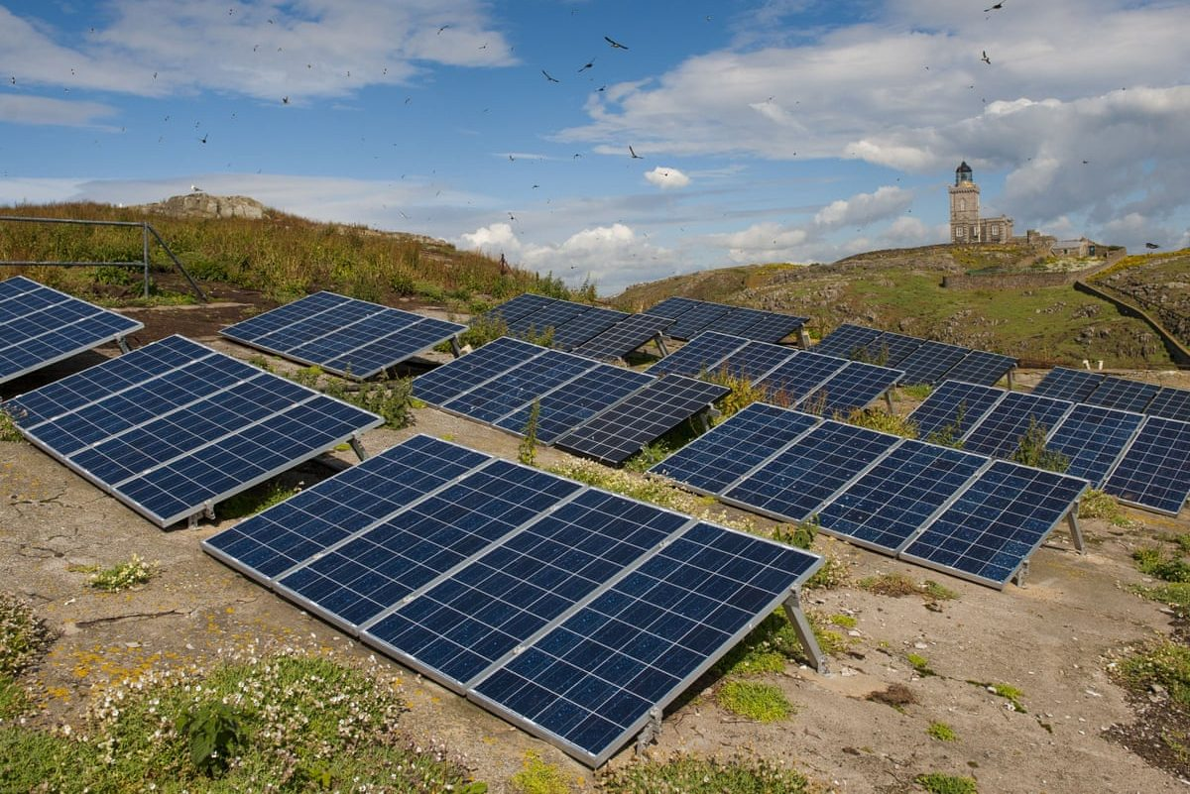
Challenges in Solar Energy Calculations
Accurate solar energy calculations require detailed data on solar radiation, weather conditions, and system performance.
Obtaining accurate data can be challenging, especially in remote or poorly monitored locations.
Uncertainties in solar energy calculations can impact the financial viability and performance of solar energy systems.
Notes:
Image source: https://www.relocalize.net/energy/the-challenges-of-solar-energy

Slide 12
Government Incentives and Policies
Governments worldwide offer various incentives and policies to promote solar energy adoption.
These may include tax credits, grants, rebates, and low-interest loans for solar energy system installations.
Feed-in tariffs and renewable portfolio standards also play a significant role in encouraging renewable energy generation.
Notes:
Image source: https://www.linkedin.com/pulse/how-do-governments-offer-incentives-different-eu-countries-promote

Slide 13

Case Study: Solar Energy Calculation for Residential System
In this case study, we will calculate the potential energy output of a residential solar energy system.
Factors such as roof orientation, shading, and system size will be considered.
The solar energy calculations will demonstrate the system's financial and environmental benefits.
Notes:
Image source: https://fokabs.com/fr/feasibility-study-of-solar-photovoltaic-systems-for-energy-in-residential-homes-a-case-study-of-metropolitan-lagos-nigeria-3/

Slide 14
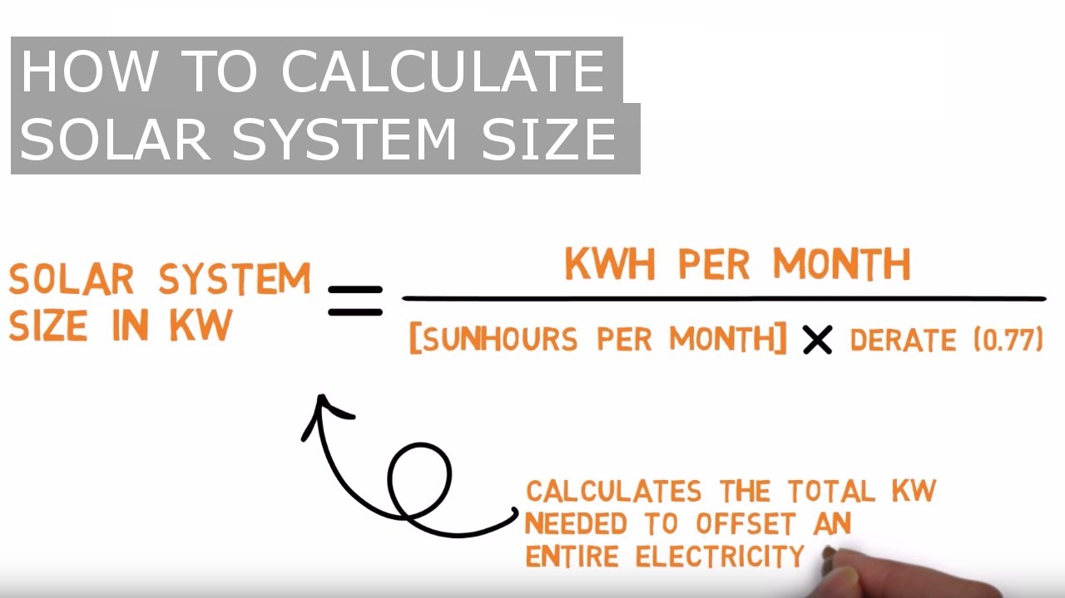
Case Study: Solar Energy Calculation for Utility-Scale System
In this case study, we will explore the solar energy calculations for a utility-scale solar power plant.
The impact of factors like land availability, panel efficiency, and solar resource will be evaluated.
The case study will highlight the importance of accurate solar energy calculations for large-scale projects.
Notes:
Image source: https://www.hierarchystructure.com/solar-system-calculator-k.html

Slide 15

Advancements in Solar Energy Technologies
Ongoing research and development efforts are improving the efficiency and affordability of solar energy technologies.
Innovations such as perovskite solar cells and bifacial panels are enhancing energy generation capabilities.
Emerging technologies like solar windows and solar-powered electric vehicles are expanding the applications of solar energy.
Notes:
Image source: https://jtechconst.com/blog-content/solar/solar-power-advancements/

Slide 16
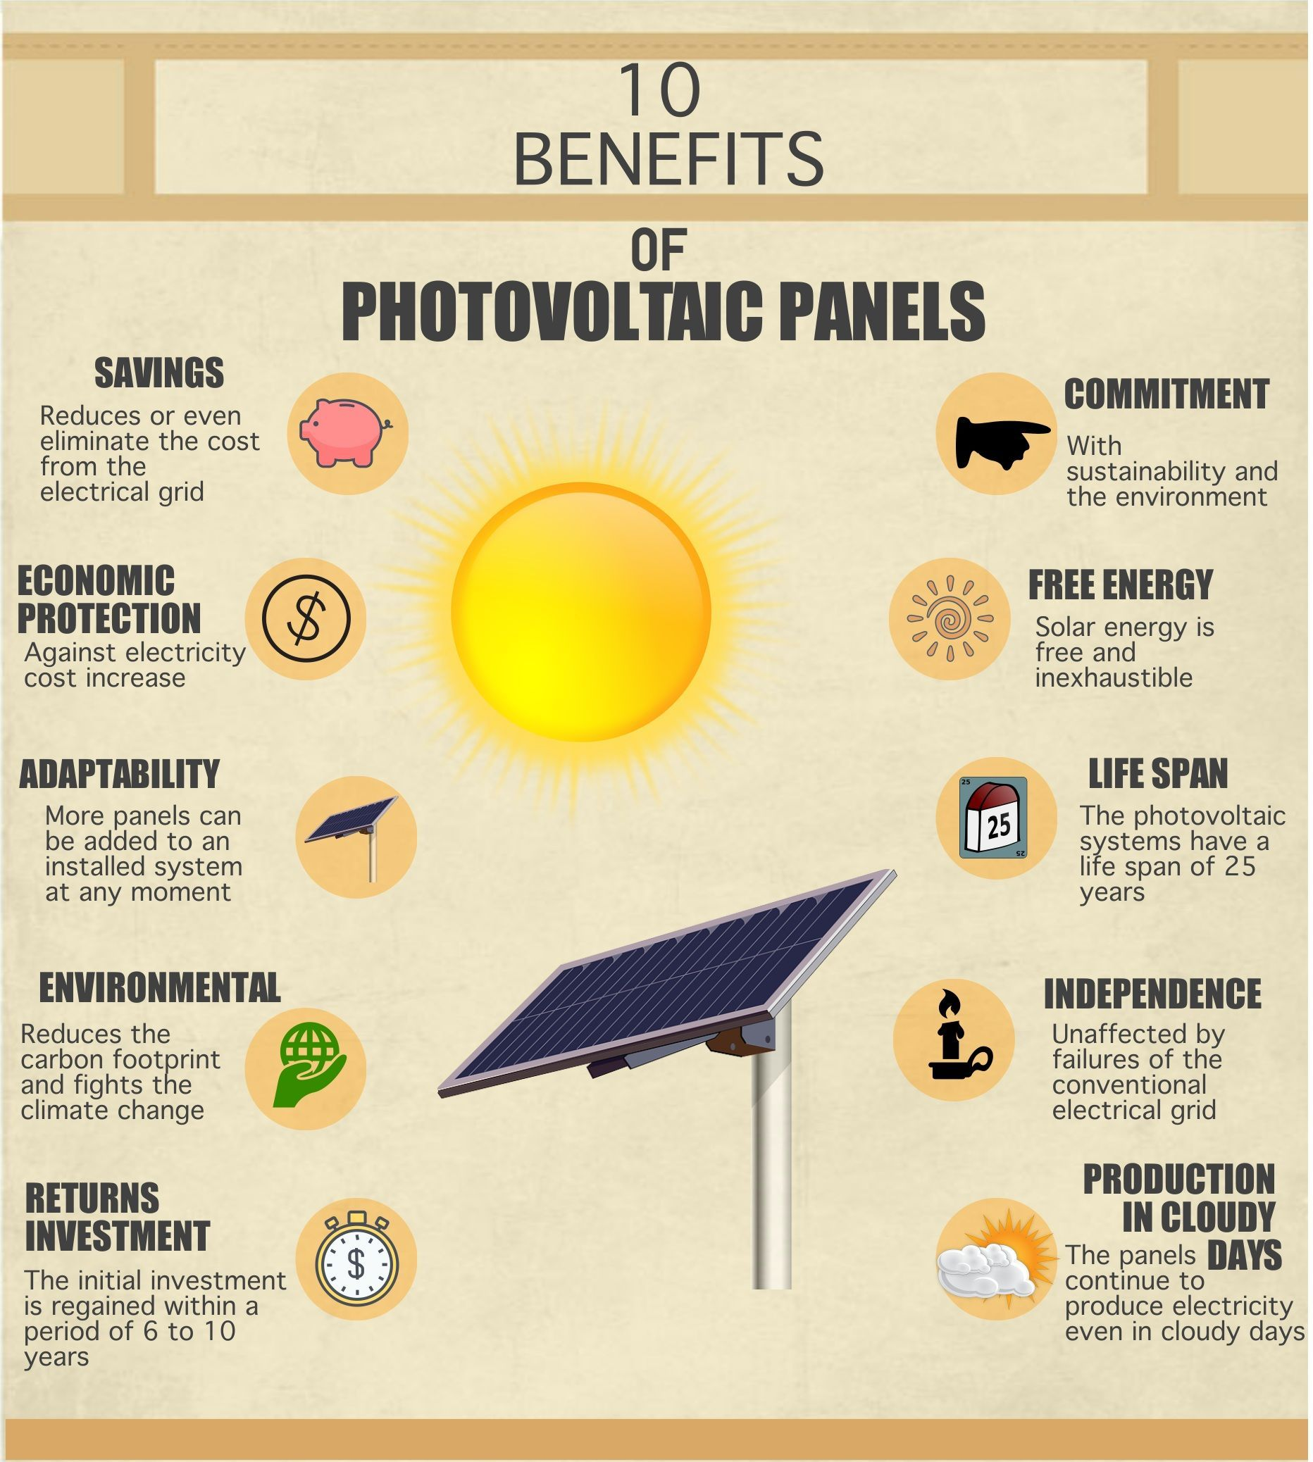
Environmental Benefits of Solar Energy
Solar energy reduces greenhouse gas emissions, air pollution, and dependence on fossil fuels.
It contributes to combating climate change and improving air quality and public health.
The adoption of solar energy helps preserve natural resources and ecosystems.
Notes:
Image source: https://www.pinterest.com.mx/pin/736971926498778893/

Slide 17
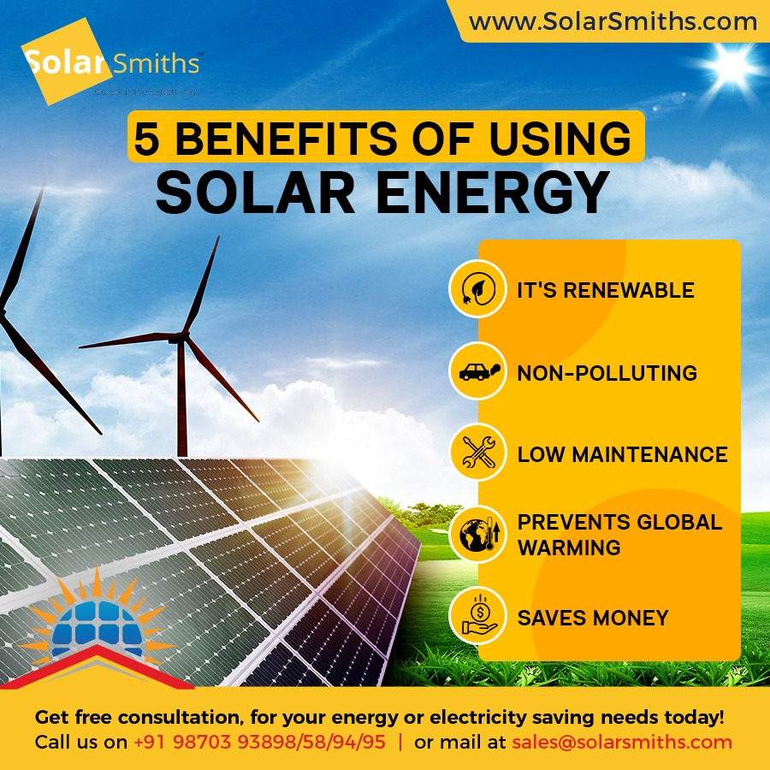
Economic Benefits of Solar Energy
Solar energy creates jobs in manufacturing, installation, and maintenance sectors.
It stimulates local economies and reduces energy costs for consumers.
The solar industry's growth contributes to economic stability and energy independence.
Notes:
Image source: https://www.solarsmiths.com/blog/5-benefits-of-using-solar-energy/

Slide 18
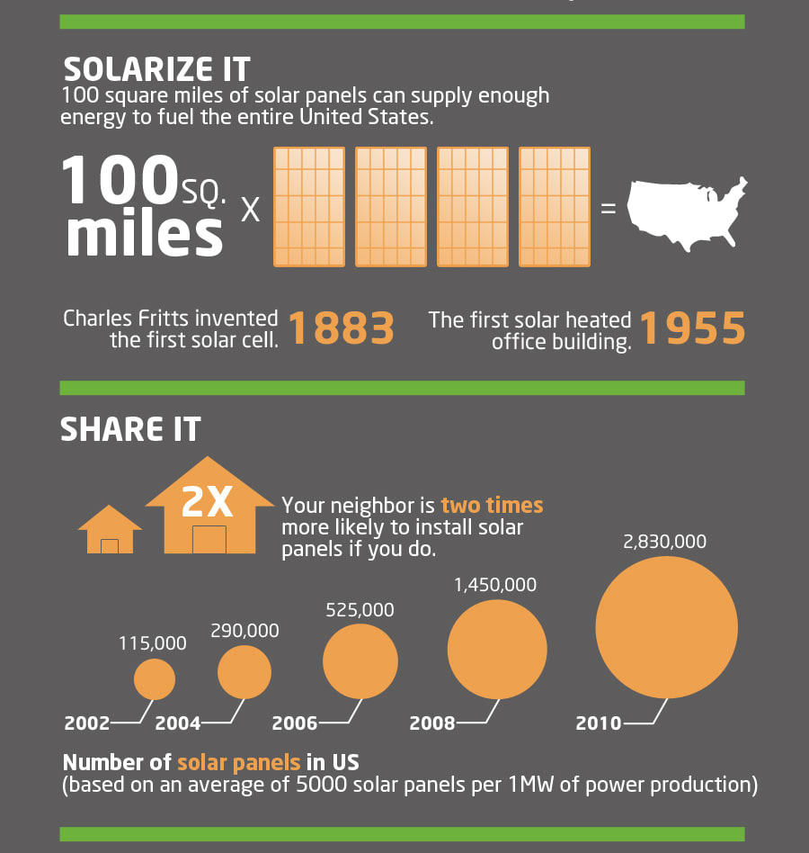
Social Benefits of Solar Energy
Solar energy increases energy accessibility, particularly in remote or underprivileged areas.
It improves energy security, especially during natural disasters or grid failures.
Solar energy empowers communities to participate in sustainable energy generation.
Notes:
Image source: https://www.expertise.com/roofing/home-solar-panels-pros-cons-and-hidden-costs

Slide 19

Future of Solar Energy
The future of solar energy looks promising, with continued advancements and cost reductions.
Integration with energy storage systems and smart grid technologies will enhance reliability and flexibility.
Solar energy will play a crucial role in achieving a sustainable and renewable energy future.
Notes:
Image source: http://energy.mit.edu/research/future-solar-energy/

Slide 20
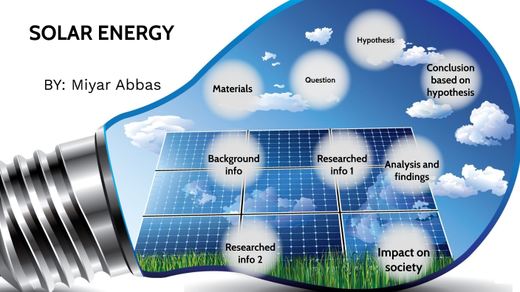
Conclusion
Solar energy calculations are crucial for estimating the energy output of solar power systems accurately.
Renewable energy sources, such as solar energy, are essential for a sustainable and clean energy transition.
Investing in solar energy and renewable energy sources benefits the environment, economy, and society.
Notes:
Image source: http://api-stg.3m.com/conclusion-of-solar-energy.php

